Slide 1
Srinivasan A

Slide 2
SUMMARY
Crude Oil Price Prediction based on Historical Data
Model used : ARIMA (Auto-Regressive Integrated Moving Average)
Software: R (for data mining and Analysis)
Visualizations: Excel and Tableau
Missing Values: Imputed (Other methods did not significantly change the model)

Slide 3
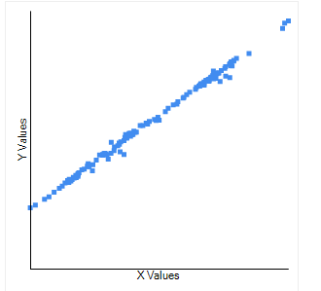
5 Insights from Data
Insight 1:
Strong Positive Correlation between the data:
Data 1: The correlation is 0.947
Data 2: The Correlation is 0.9977
It seems that the correlation of the data is high. This means that values vary together.

Slide 4
Insight 2:
Prices of Crude Oil was highest in 2008 (May – July)
The values are for Dollars per Barrel:
Date | Cushing, WTI Spot Price FOB | Europe Brent Spot Price
June 2008 | 133.88 | 132.32
July 2008 | 133.37 | 132.72

Slide 5
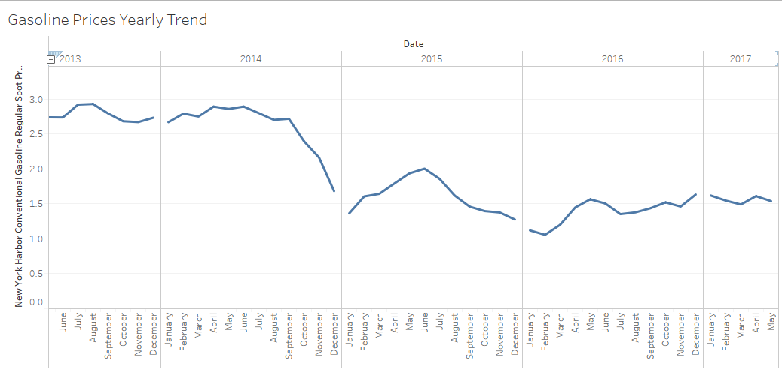
Insight 3:
Significant drop in the Average Conventional Gasoline prices (New York) from 2015 onwards
Tableau Workbook provided in Folder

Slide 6
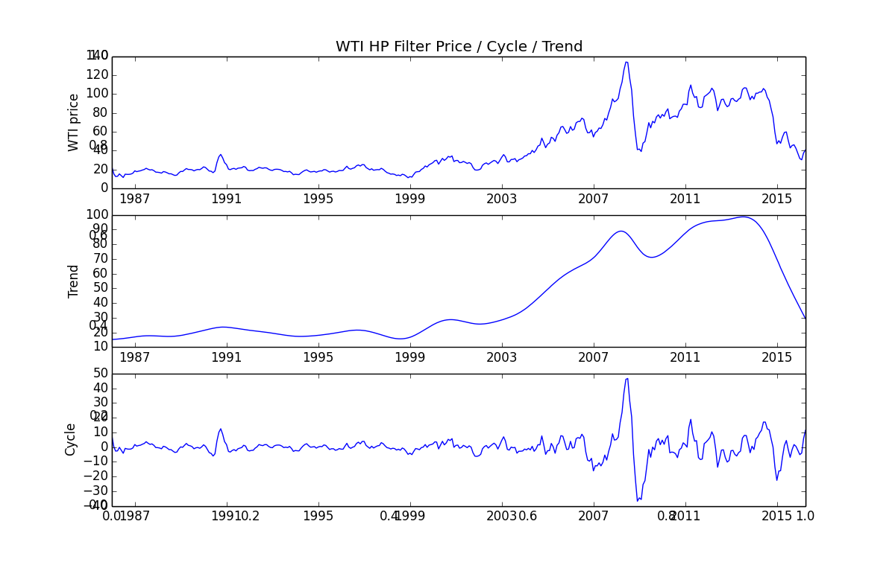
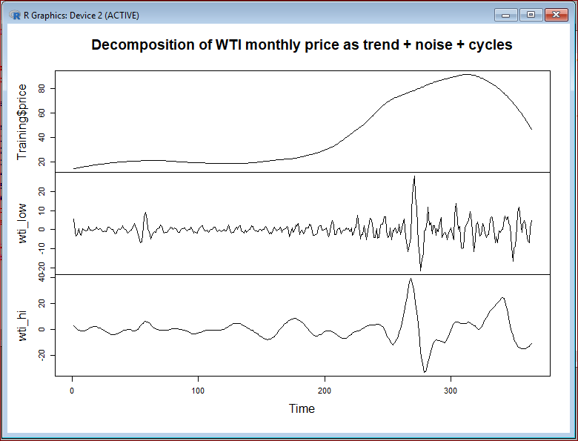
Insight 4:
There is a sudden price rise and then decrease in 2008.
The fluctuation in price is more intensive after 2005 which can be see from the graph. This shock suggest the volatility of price.
From the graph we can infer the following:
Trend : Increasing
Price: Volatile
Cycle: Repeated up’s and downs

Slide 7
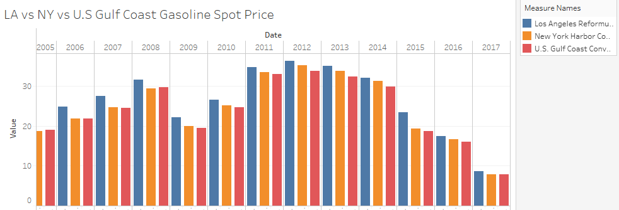
Insight 5:
Comparing the Gasoline Spot prices for New York, Los Angeles and U.S. Gulf Coast, we find that prices are the highest for the reformulated RBOB Gasoline Spot Price (LA). The reason for the price is because of the additional overhead of Re-formulating the fuel.

Slide 8
2.Possible Link Between Petroleum price and External factors
The prices of Petroleum and its derived products depend on the price of the crude oil.
The steep surge in the prices of Crude oil in the Year 2008 ( May-June-July) was because of the following reasons
Decrease in non-OPEC supply and surge In Global Gasoline Demand
Feb 2008 Venezuela Cut-off oil to ExxonMobil
Iraq wartime caused the oil supply to decrease
The are also other factors such as UK North Pipeline shutdown etc. which caused the price surge
How does this effect our prediction?
→Spikes or outliers cause the average to move in their direction. If this spike is not smoothed out, the predicted prices will be higher as the spike will be taken into consideration causing our error to increase.
3. Price change over month (Performed in Excel sheet itself)

Slide 9
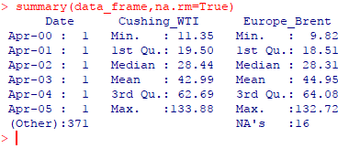
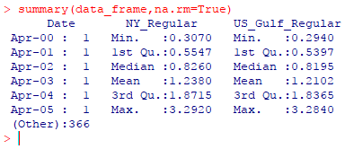
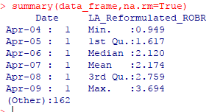
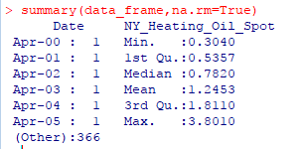
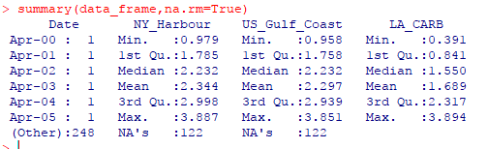
4. Summarized Price and Price Movement (Each year)
The Visualizations are present in the Tableau File
Data 1: Crude Oil
2. Conventional Gasoline
Data 3: RBOB LA Regular Gas
Data 4: heating Oil (NY Spot Price)
Data 5: Ultra-Low Sulphur Diesel

Slide 10
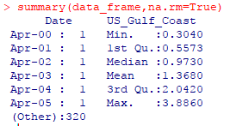
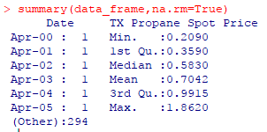
Data 6: Kerosene Type: Jet Fuel
Data 7: Propane TX Spot Price

Slide 11
6. Predict Crude Oil for Next 6 months
Steps Performed
Initial Analysis
Read Data
Basic Data Cleaning
Build Model
Smooth The spikes in data
Predict
Test on Existing data
Train ARIMA model
Predict Future values

Slide 12
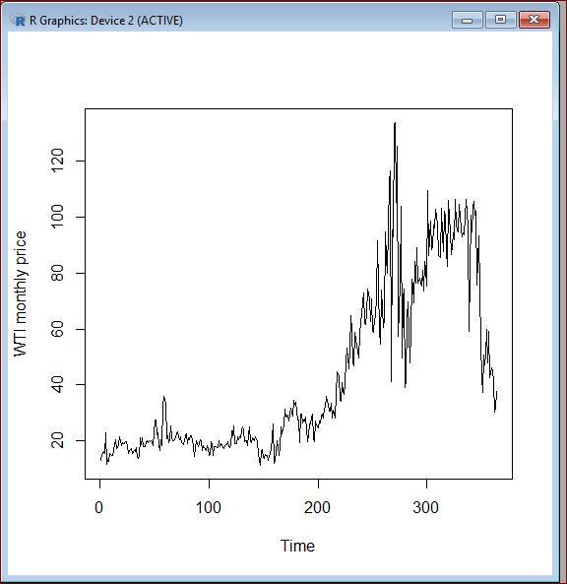
Divided data into Training and testing sets
Test Set – May 2016 to May-2017
Training Set – From Jan 1986 to Apr 2016
Looking at the graph we can see that the WTI (Cushing) and BRT(Brent) prices are almost similar. Hence using only WTI for model and prediction.
To support the above, the correlation between WTI and BRT is : 0.947 which is high
Correlation suggest the similarity of the data
Detailed Steps:
Read the Training dataset CSV and
removed the BRT (Brent Europe column)
Plotting the Graph of WTI (Cushing Price),
we see that the data is not stationary at all
Note: R code is provided in the R file. I have not included the codes in the slide.

Slide 13
Detrend the Data (HP Filter)
We need to detrend the data to perform the time series analysis.
The graph shows that the trend is increasing
Price highly fluctuating after 2005
We have some white noise as well
Conclusion:
Cannot perform the ARIMA analysis using
The HP filter
.

Slide 14
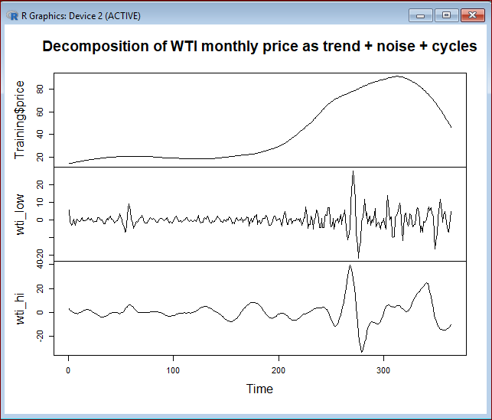
Loess Filter Analysis
The HP filter failed to smooth the noise and hence I choose to try with Loess Filter
Though it can be seen that the shock has been smoothed for some extent still we have got ample fluctuations in price.
Conclusion:
Loess Filter failed to provide the necessary smoothing and stationing the data.

Slide 15
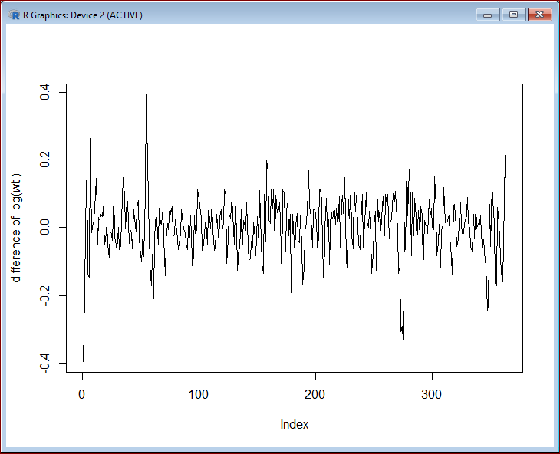
Log Transformation (Difference)
After taking the difference of log transformation, we see that the actual price is now stationary for our analysis.
The key point to do any time series analysis using ARIMA/ARMA models is the series should be stationary
Model Selection
After multiple trials on different ARIMA model, I have taken the SARIMA(2,1,2) x (1,0,1) model because this had the lowest AIC

Slide 16
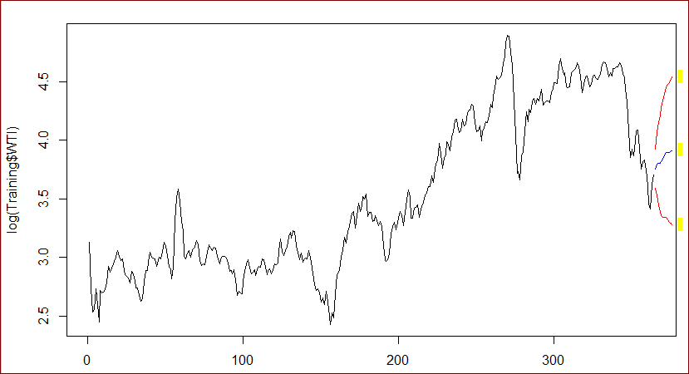
Model Training and Forecasting
The model has been trained on the training data set, tested using test data set and then forecasted the price.
Below graphs show the model’s prediction
Blue Line -> Predicted value
Red Lines -> Higher and Lower limits at confidence level 80% and 95%

Slide 17
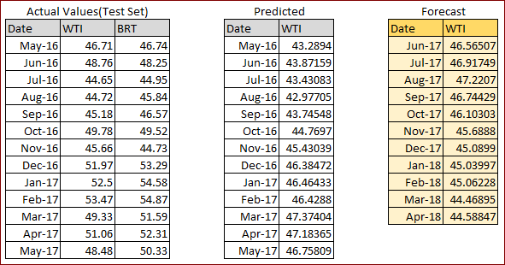
FINAL RESULTS
The table shows the final predicted values.
The test data (May-16 to May-17) and Predicted Values are quite similar.
The Forecasted values are for duration Jun-17 to Apr-18
The Predicted values are mean of High and Low values with confidence intervals of 80% and 95%.
Conclusion: The model performance is pretty good on the test data set. It can be observed that the price change is not as volatile as the actual values when compared with the model.

Slide 18
6. Identify Co-relation between Conventional Gasoline Prices between NY and Gulf Coast
→The Correlation is 0.9980088 ( Used R )
7.Is there a month/quarter/year where prices of all Products were lower than prior data points
→ March 1998

